Slide 1

MAGS MECHANISED AIR AND GAS STATION A Cost and Time Efficient Solution for Fuel Station Automation
EE5109 – APPLICATION OF MECHATRONICS (DESIGN PROJECT)
Swardheep Vignesh K
Nikila Vignesh L
Meenakshi Sathriya
GROUP 1 – PRESENTATION II

Slide 2
System Design
Recap
Hardware Configuration & Estimate
Problems resolved
Challenges in the Proposed System
Marketing and Pricing Strategy
Agenda

Slide 3
RECAP OF PRESENTATION I
Introduction – Why we need to go for automation in fuel filling stations?
Challenges with the Existing Model
1. Time Consumption
2. Dependency on Manual Operation
3. Non – Automation of Tyre inflation
4. User Friendliness
Proposed System Architecture - Block Diagram of Air and Fuel Filling Units
Logical flow of Process – Stepwise flow of processes of individual Units
First Level, Camera Control Unit, Registration Unit, Fuel Filling, Air Pressure, Payment and Mobile Application
Market Analysis
1. Market Survey
2. Competition Analysis
3. Patents Check
4. Target Customers

Slide 4
System Design
Recap
Hardware Configuration & Estimate
Problems resolved
Challenges in the Proposed System
Marketing and Pricing Strategy
Agenda

Slide 5


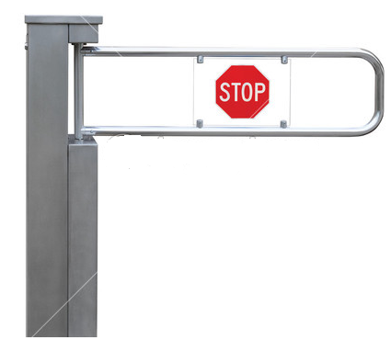
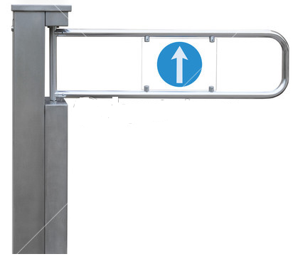
OVERALL SCHEMATIC OF PROPOSED SOLUTION
Vision software to detect car’s model and identify fuel lid location
Bay 3
Fuel Filling movable arms
Bay 2
Go to Bay 2
Tyre air Inflation terminals
Bay 1

Slide 6
FUEL FILLING UNIT - DESIGN
Movement along base – X axis
Vertical movement – Z axis
Horizontal Movement of the Nozzle – Y axis
VEHICLE PARKING BAY
Fuel arm movement is guided by the Camera Unit, which will provide the information on required movement in X, Y and Z direction based on the position of fuel cap of the vehicle.

Slide 7

AIR FILLING UNIT - DESIGN
Air Filling Nozzle
Arm from Air Pressure Measurement & Compressor Unit
Compressor Units are mounted at 4 corners
Lateral movement of air filling arm is aided by the Camera Unit by providing the position of centre point of tyres
Position of air filling nozzle in tyres is identified by Laser / Infra-red system mounted on the air filling arm. It will pass rays in 360 degrees along the radius of the tyre. Point of air nozzle is identified by tracking the reflection from it.

Slide 8
System Design
Recap
Hardware Configuration & Estimate
Problems resolved
Challenges in the Proposed System
Marketing and Pricing Strategy
Agenda

Slide 9
SCHEMATIC OF FUEL FILLING UNIT
A1- ACTUATOR FOR MOVING THE ROBOT TOWER (HORIZONTALLY).
A2-ACTUATOR FOR MOVING THE ROBOTIC TOWER
(VERTICALLY).
A3-ACTUATOR FOR MOVING THE ROBOTIC ARM (LATERALLY).
A4-ACTUATOR FOR MOVING THE ROBOTIC ARM (PRECISION MOTION).
A5-360 DEGREE ROTATING ACTUATOR FOR SELECTION OF TOOL TIP .
S1-ULTRASONIC SENSOR
S2-ENCODER
T1-FUEL CAP ACCESS DOOR OPENER/CLOSER
T2-FUEL CAP REMOVER
T3-FUEL FILLING NOZZLE

Slide 10
SCHEMATIC OF AIR FILLING UNIT
A1-ACTUATOR FOR MOVING THE ROBOT TOWER (HORIZONTALLY).
A2-ACTUATOR FOR MOVING THE ROBOT TOWER (VERTICALLY).
A3-ACTUATOR FOR MOVING THE ROBOTIC ARM (LATERALLY) .
A4-ACTUATOR FOR MOVING THE ROBOTIC ARM (PRECISION).
S1-LASER SENSOR
T1-AIR CAP REMOVER
T2-AIR FILLING NOZZLE

Slide 11
HARDWARE COST
LIST OF COMPONENTS | SPECIFICATIONS | REASONS FOR CHOOSING | ESTIMATED COST
ACTUATOR FOR MOVING THE ROBOT TOWER | Linear actuator / electric / with servo-motor / belt-drive ACT165DL series | Less maintenance cost. | $1000.00
ACTUATOR FOR MOVING THE ROBOTIC ARM |  |  | $1000.00
FUEL FILLING NOZZLE | OPW 7H® And 7HB® Automatic Shut-Off Nozzles | Flowlock feature allows the nozzle to shut off at the right time and reduces spillage. | $200.00
FUEL CAP REMOVER | TRITEX II™ AC ROTARY ACTUATOR | Eliminates costly, high-maintenance servo cables. | $500.00
FUEL CAP ACCESS DOOR OPENER/CLOSER | SF-ROB-10398 | Less power consumption and provides enough suction to open small vehicle doors. | $100.00
360 DEGREE ROTATING ACTUATOR FOR SELECTION OF TOOL TIP | AGC-40 TOOL CHANGER SYSTEM | Fail Safe - The locking mechanism remains locked even with loss of pneumatic pressure. | $750.00
ULTRASONIC SENSOR FOR DETECTION OF FUEL FILLING CAP DOOR AND FUEL TANK CAP | wms ultrasonic sensors | High Repeatability and accuracy. | $41.23
ENCODER FOR DETECTION OF CURRENT POSITION OF THE FUEL FILLING ARM | Series HS35R – Sealed Hollow shaft Encoder | Optical encoder does not have electromagnetic interference compared to other magnetic encoders | $50.00
LASER SENSOR FOR DETECTION OF THE AIR FILLING NOZZLE | LIDAR lite | Higher precision and can easily detect smaller holes. | $400
 |  | TOTAL | $4041.23

Slide 12

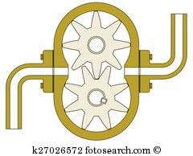
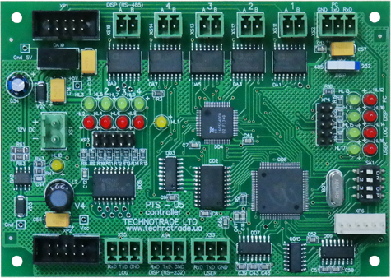
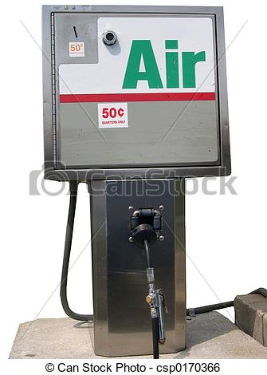





INTEGRATED CONTROL SYSTEM
Model
Payment Mode
Fuel Type
Required Fuel
Fuel arm Control
Valve Opening
Pump Control
Valve Closing
Vehicle User Information
Fuel Filling
Camera Unit
Model Identification
Locating Fuel valve
Locating air nozzle
Arm Control
Air Nozzle Opening
Air Nozzle Closing
Pressure Check
Air Filling
Sensor Unit
Detection of Valve doors
Positioning check
Vehicle Positioning in Bays
Payment information
User Information
Status for Monitoring
Actuator Control
Precision Check
User Interface
Level Checks
Data Storage
Feedback
Control
Alarm Signals
Safety Alert
Component Failure
Information
Fuel Sump Check
Safety monitoring
Payments
Condition monitoring
Safety System
Monitoring
INPUT SIGNALS
OUTPUT COMMANDS

Slide 13
CONTROL SYSTEM - FEATURES
FUEL FILLING CONTROLLER
AIR FILLING CONTROLLER
ACTUATORS CONTROLLER
PTS CONTROLLER
Technotrade Ltd - Make
Fuel Pump Control and Automatic Tank Gauge
Voltage – 12 V DC
Supported with Communication protocols
Graphic User Interface feature
Global Compatibility
MICROLOGIX 1000
Allen – Bradley Make
Input – 4 to 20 mA Analog
Output – Digital Signal to Compressor Unit
To Use Smart Pressure Transducer to convert Pressure to Current
RS232 Connectivity
Involves Closed loop control
ACT165DL Driver
Aerotech Make
Super-smooth velocity and position control
Tested and Proven system
Used in Robotic arms
Flexibility in controlling the parameters like speed, torque through user interface
Maximum speed at full load – 5m/s
Integration of all these Controllers through a common platform to reduce processing time is being looked into

Slide 14
OVERALL COST ESTIMATION
RESEARCH AND DEVELOPMENT
$5,000
HARDWARE
$4041.23
$24,041.23
ASSEMBLING AND INSTALLATION
$10,000
TECHNOLOGY PARTNERSHIPS
$5,000

Slide 15
OVERALL COST ESTIMATION
RESEARCH AND DEVELOPMENT:
The R&D cost for the petrol stations is expected to be less since we are using existing parts available in the market.
HARDWARE:
The overall hardware cost might vary depending on the customer requirements.
ASSEMBLING AND INSTALLATION:
The assembling costs might be a bit higher in our model because integration of all the hardware components requires additional manpower.
TECHNOLOGY PARTNERSHIP:
The technology partnership costs are bound to be a constant one.
An Existing product available in the market was developed by husky.
It costs around $50,000 excluding the installation charges.
It only provides fuel automation and does not include the air filling automation.
Our product provides one stop solution for both fuel filling and air filling at a far lesser cost.

Slide 16
System Design
Recap
Hardware Configuration & Estimate
Problems resolved
Challenges in the Proposed System
Marketing and Pricing Strategy
Agenda

Slide 17


PROBLEM RESOLVED – TIME CONSUMPTION
Communication Delay
For 10 pumps in parallel for 1Kb transfer (instruction to & from pump) communication time
T_comm= 10 * 1/200 + 1/10 * 1/20 = 55 ms
Worst case T_comm = 110 ms = 2*T_comm (based on through put)
Computation Delay
1GHz Processor with 500,000 line of code for controlling the fuel and air unit
T_comp= 500,000* 10^-9 = 0.05ms
Worst case T_comp = 0.1 ms = 2*T_comp (based on through put)
“Negligible Delay”
Other Delays
Entry gate = 10 to 20s
Conditional Registration step = 0 to 60s
Positioning of car = 20 to 30s
Positioning of fuel and air nozzles (only micro level)= 10 to 20s
Cap removal = 10 to 20s
Fuel/ Air filling = 10 to 20s
Exit gate including payment approval = 30 to 40s
Best case time estimate = 82s = 1min 22sec
Worst case estimate = 190s = 3min 10 sec
Target Achieved Reduced time by > 50%
The chosen controllers require CPU/PC with at least 1GHz clock frequency
RS232 for interconnect to processor– 20Kbps
RS485 for interconnect from processor– 200Kbps

Slide 18


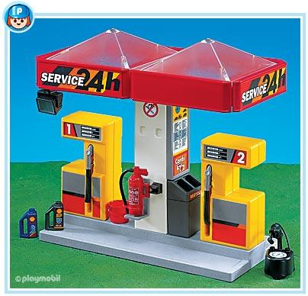


PROBLEMS RESOLVED
Alarm Trigger – Payment Pending
Controller manipulated fuel filling warrant against - Fuel theft and Mishandling
Gates at entry and exit checkpoints ensure “Drive off’s” are not possible
Fuel Theft
Integration of dedicated Tyre Inflation Unit with fuel filling bay guarantee optimal usage of space allotted for fuel station
Space Constraint
Encrypted software systems and mode of communication between various wirelessly operated systems within station
User data privacy guaranteed by means of employing stringent Database maintenance standards
PTS controller employed can use upto 3 different communication protocols
Data Security
Resort to Fire and explosion safety standards
Safe and Secure

Slide 19

LAYOUT OF EXISTING FUEL STATION
Fuel Station Office
Underground fuel storage unit beneath the pumps
Integration of Tyre Inflation unit in proposed system
P1
P2
P3
P4
Vehicle Bay
Y Meters
Air Filling location
Tyre Inflation Unit
Entry Gate
Exit Gate
X Meters

Slide 20
LAYOUT OF PROPOSED FUEL STATION
Fuel Station Office
Underground fuel storage unit beneath the pumps
Existing system Area = xy sqm
Proposed system Area = 0.7xy sqm
Optimized Area is 30%
P1
P2
P3
P4
Vehicle Bay
Further optimization is envisaged, from reduction in design size of fuel pump outlet.
Minimum 30% saving in space is easily achievable from combining the air filling and fuel filling locations.
In addition, office space can also be reduced due to elimination of manual operation in the proposed system.
Y Meters
Entry Gate
Exit Gate
0.7 X Meters

Slide 21
System Design
Recap
Hardware Configuration & Estimate
Problems resolved
Challenges in the Proposed System
Marketing and Pricing Strategy
Agenda

Slide 22

CHALLENGES
Challenges | Proposed Solution
Support to fill engine oil | Most cars is don’t maintain appropriate engine oil level. Filling of engine oil in an completely automated way will be different from the fuel filling prototypes
How to install this solution without shutting down the station | In this proposed model we still suggest the petrol station to have a manual outlet during the installation phase. The installation could be done in multiple stages - Installation of vision software - Installation of air pressure monitoring system - Installation of the fuel outlet (minor shutdown during night)
Futuristic models and customized models | It is quite hard to find the position of the fuel opening if the existing model is customized, to work seamlessly the vision software has to be improved to identify the fuel opening. Futuristic models can be easily fed to the database as and when a new car model is released by the database maintenance company
One station for all kinds of fuel | The future is going to be an era where electric vehicle, diesel vehicle, petrol/ gasoline vehicle will co-exist Yes this is a quite serious challenge but it is addressable by our design by installing 4 such system with appropriate gun for each
Different auto Payment modes for different countries | This could be challenge since the petrol price and payment gateways differ across countries. Can be answered by initiating a customization in the payment software

Slide 23
CHALLENGES
Challenges | Proposed Solution
The petrol station of present day is a place that accommodates a cleaning service for the car | This could be taken into account for further improvement but the idea here is not to perform cleaning in parallel as the infrastructure according to our design is to minimize the space
Extending the usage of user information | 1. Concern of privacy 2. If in future all the major market players of petrol station install the proposed solution, then it is a waste of time, energy and memory in database to maintain a directory for each customer in all the stations that he visits. A better proposal for a chain of petrol station will be to maintain a common database
Failure and maintenance - The system is designed in such a way that it follows all the standards but in case of failures how are we going to fix them? | 1. Software failure - Remote up-gradation of software 2. Mechanical/Electrical failure - Before the maintenance team arrives at the particular station for fixing the mechanical failure, we have planned to initiate a custom software for the entry gate and exit gate to redirect all the vehicle to manual filling outlet (within the station) to avoid any loss to the company 3. Natural calamities or other forms of unexpected events - Auto shutdown system will be put in place to safeguard the petrol station infrastructure, this can be enabled from a remote location

Slide 24
CHALLENGES - ELECTROSTATIC DISCHARGE
However, if the first point of contact with metal happens to be the fill point of the fuel dispenser nozzle, the spark can ignite the petrol vapors and cause a brief flash fire.
Since our system is automated one, the person need not come out of the vehicle and hence hazards caused due to accumulation of static charges is considerably reduced.
As a solution to the Electrostatic discharge problem, the proposed system aims to ensure
The static electricity that has been generated usually discharges when the motorist touches the metal car door on exiting.
Accidents due to static electricity are more common in fuel stations.
Proper earthing of all components in the architecture
ESD protection circuitry - Class A controller
No user induced static charge

Slide 25
CHALLENGES - ELECTROMAGNETIC INTERFERENCE
The proposed system employs Ultrasonic Sensors and Optical Encoders which are free form RF interference
However the Actuators present in the system may induce RF interference which has been eliminated through proper shielding and component specification and selection
Electromagnetic interference is another key concern present in fuel stations

Slide 26
System Design
Recap
Hardware Configuration & Estimate
Problems resolved
Challenges in the Proposed System
Marketing and Pricing Strategy
Agenda

Slide 27
PRICING STRATEGY
Configuration 1
Automatic Fuel & Air Filling – 1 Per Outlet
Configuration 2
Automatic Fuel Filling outlet only – 1 per Outlet
Configuration 3
Automatic Air Filling – 1 Per Outlet
MANDATORY SYSTEMS
OPTIONAL CONFIGURATION
Vision System – 1No. Per station
Includes Camera and associated software
Database Maintenance – 1 No. for chain of stations
Mobile Application, Network connectivity with data encryption, servers and database with respective software and maintenance
Consumption-Based Pricing Model - Initial cost with 15% margin of all components with assembling cost + for every 5% increase in no. of users additional 2% of cost payable by the customer.
Absorption Model - If purchased with at least one unit of configuration 2
Fixed pricing for standard design with a low margin will be charged from the petrol station owners
If not fixed pricing for standard design with a high margin will be charged from the petrol station owners
Pricing Pattern - Gain-Sharing Pricing Model between the vision makers and us, initial cost for development will be bared by us and the vision makers / software developers
Absorption pricing - A fixed pricing for standard design with a high margin will be charged from the petrol station owners
Breakeven can be achieved easily as fixed cost (R&D) involved is comparatively low.

Slide 28



TECHNOLOGY PARTNERSHIPS
Vision system
Dynamic Ventures, Inc
Extract information from images and videos
Database
BestITExperts
Cost saving
Payment solutions
ezidebit
Put Computer Vision and Image Recognition to work for you.
Recognize single patterns from many possibilities
http://imagerecognitionsoftware.biz/
Resource focus
Higher quality of service
http://www.bestitexperts.com/database-services.html
With Ezidebit Direct Debit, you can create recurring payments that are fully automated
Automatic payments
http://www.ezidebit.com/au/payment-solutions/direct-debit/
Though the system involves complex architecture, the integration is easily achievable through customization of high end technologies already available in the market.

Slide 29
WE WISH MAGS BECOMES A REALITY
THANK YOU

